Slide 1
Lesson 2: linear expressions and equations
Introduction to Electronics - mathematics

Slide 2
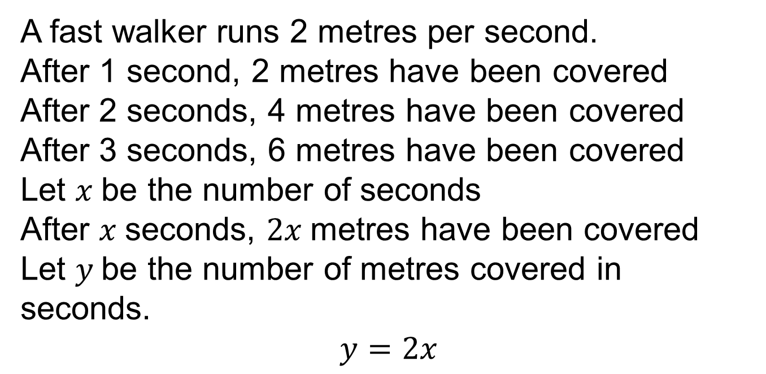
Linear relationship
A fast walker runs 2 metres per second.
After 1 second, 2 metres have been covered
After 2 seconds, 4 metres have been covered
After 3 seconds, 6 metres have been covered
Let $x$be the number of seconds
After $x$seconds, $2x$metres have been covered
Let $y$be the number of metres covered in seconds.
$$y=2x$$

Slide 3
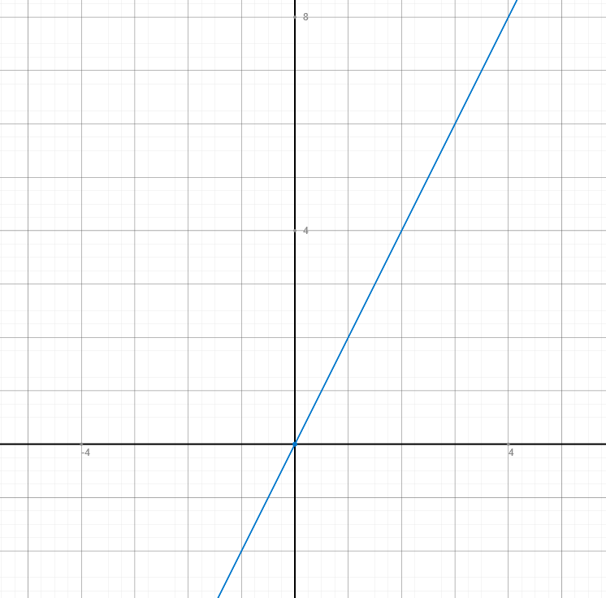
x | y
1 | 2
2 | 4
3 | 6
4 | 8
5 | 10
6 | 12
0 | 0
-1 | -2
-2 | -4
4
2
-1
1
2
-2

Slide 4
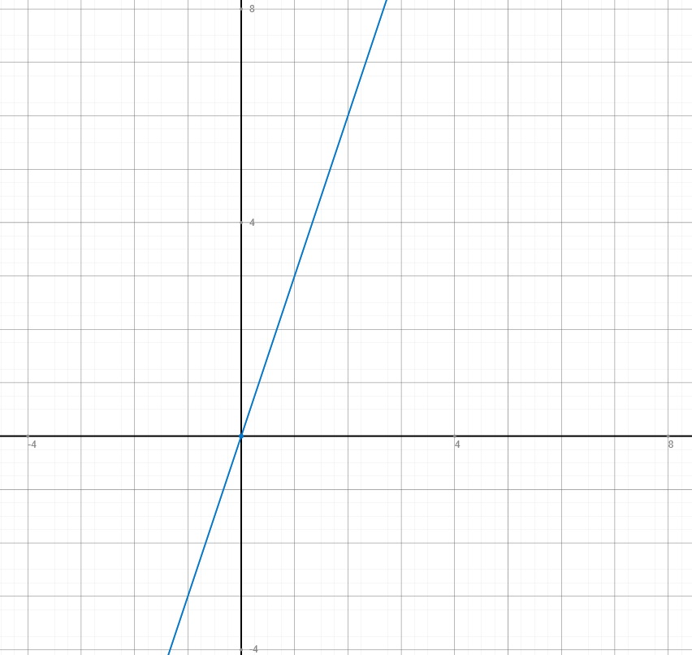
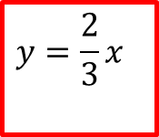


$$y=3x$$
$$y=\frac{2}{3}x$$
$$y=−2x$$

Slide 5
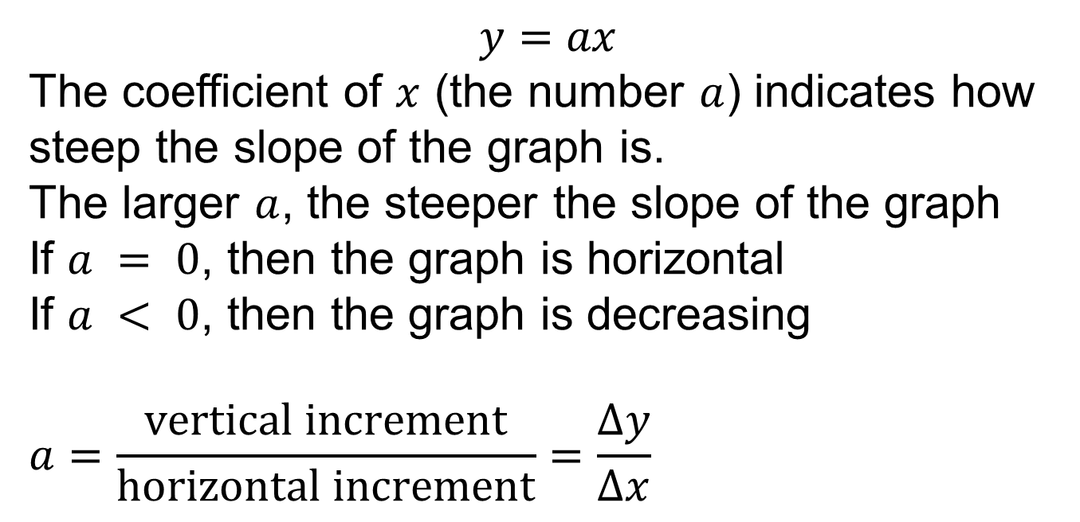
Slope
$$y=ax$$
The coefficient of $x$ (the number $a$) indicates how steep the slope of the graph is.
The larger $a$, the steeper the slope of the graph
If $a = 0$, then the graph is horizontal
If $a < 0$, then the graph is decreasing
$$a=\frac{vertical increment}{horizontal increment}=\frac{∆y}{∆x}$$
Counting grid boxes!

Slide 6


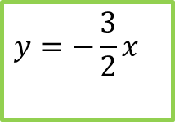
$$y=3x$$
$$y=\frac{1}{3}x$$
$$y=−\frac{3}{2}x$$

Slide 7
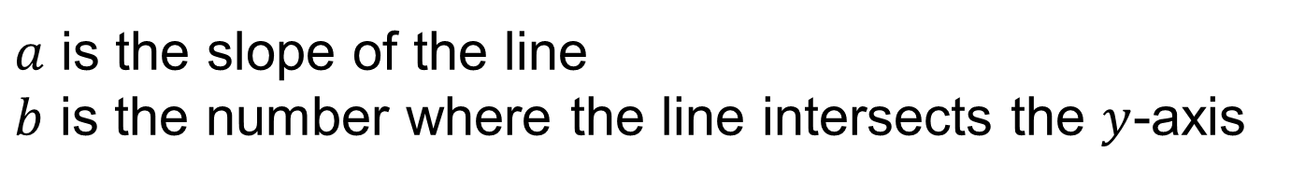

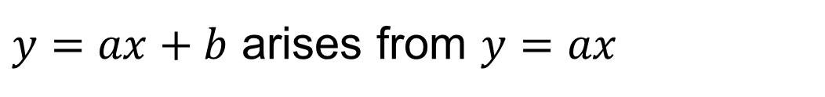
Translation
$y=ax+b$
$a$ is the slope of the line
$b$ is the number where the line intersects the $y$-axis
$y=ax+b$ arises from $y=ax$
by translating it up over a distance $b$

Slide 8

$$y=3x$$
$$y=3x+2$$
2

Slide 9
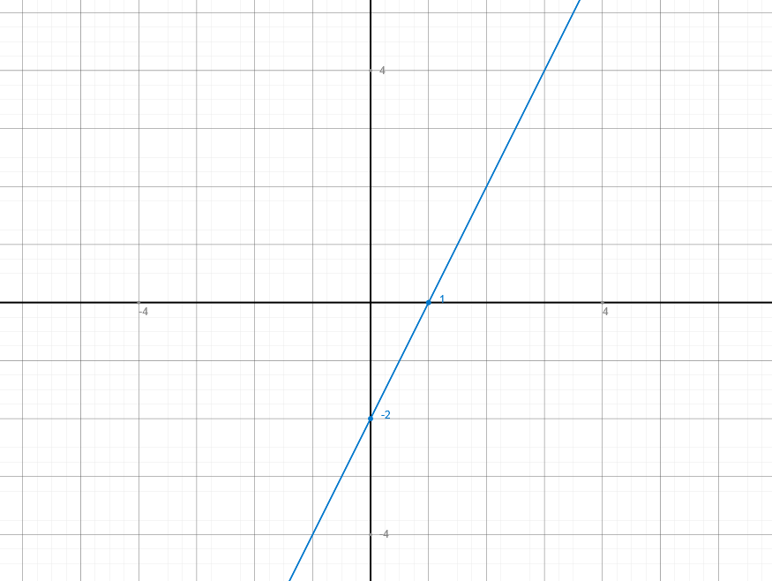
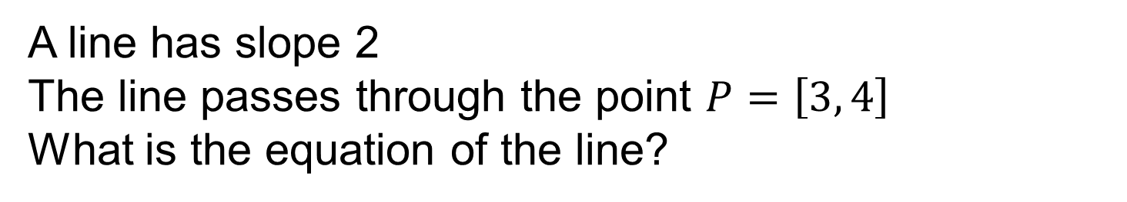
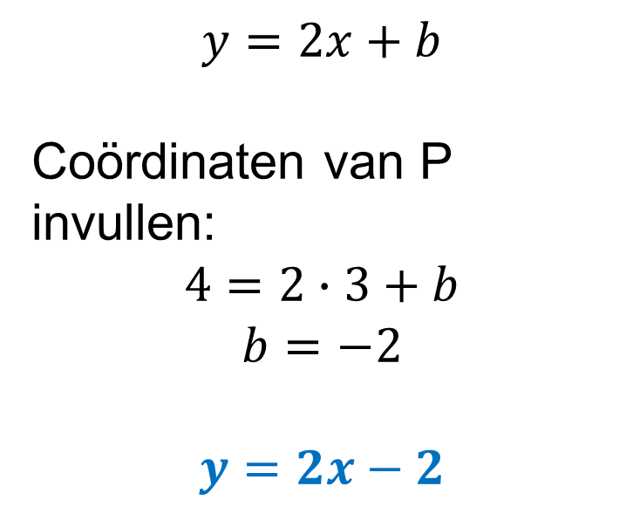
Line through a point with a given slope
A line has slope 2
The line passes through the point $P=\left[3, 4\right]$
What is the equation of the line?
$$y=2x+b$$
Enter coordinates of P:
$$4=2∙3+b$$
$$b=−2$$
$$y=2x−2$$
P
4
3

Slide 10
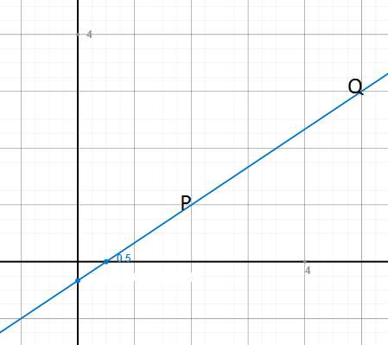
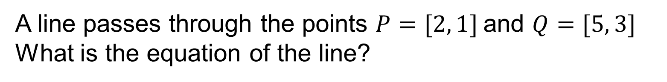
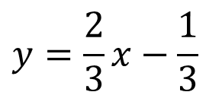
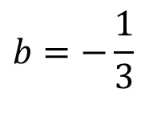
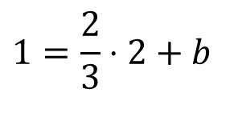
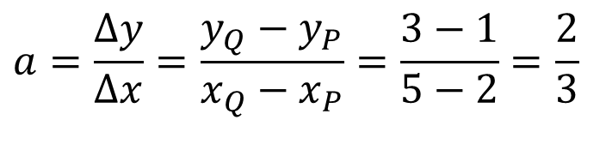
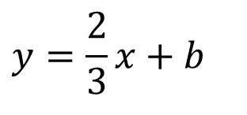
Line through two points
A line passes through the points $P=[2, 1]$and $Q=[5, 3]$
What is the equation of the line?
$$a=\frac{Δy}{Δx}=\frac{y_{Q}−y_{P}}{x_{Q}−x_{P}}=\frac{3−1}{5−2}=\frac{2}{3}$$
$$y=\frac{2}{3}x+b$$
Enter coordinates of P:
$$1=\frac{2}{3}⋅2+b$$
$$b=−\frac{1}{3}$$
$$y=\frac{2}{3}x−\frac{1}{3}$$

Slide 11
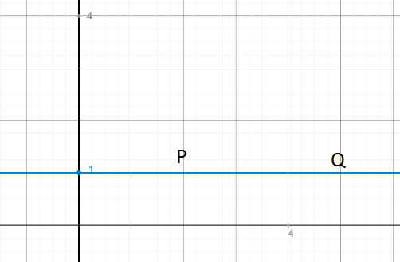
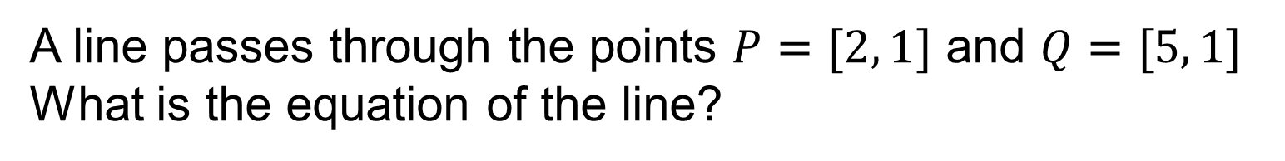


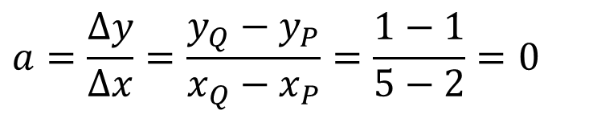
Line through two points
A line passes through the points $P=[2, 1]$ and $Q=[5, 1]$
What is the equation of the line?
$$a=\frac{Δy}{Δx}=\frac{y_{Q}−y_{P}}{x_{Q}−x_{P}}=\frac{1−1}{5−2}=0$$
$$y=0⋅x+b$$
Enter coordinates of P:
$$y=1$$

Slide 12
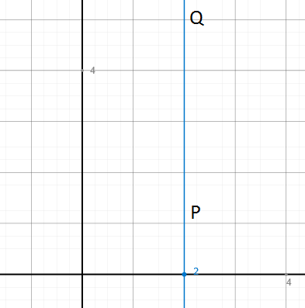
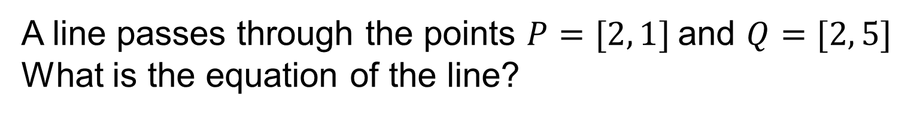

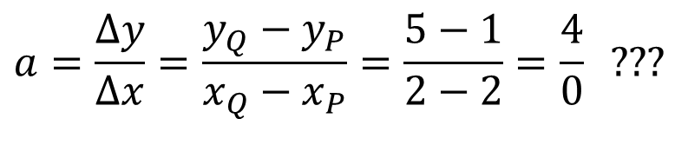

Line through two points
A line passes through the points $P=[2, 1]$and $Q=[2, 5]$
What is the equation of the line?
$$a=\frac{Δy}{Δx}=\frac{y_{Q}−y_{P}}{x_{Q}−x_{P}}=\frac{5−1}{2−2}=\frac{4}{0}\text{ ???}$$
$x=$ “something”
Enter coordinates of P:
$$x=2$$

Slide 13
Linear equations
An equation is a relation in which two expressions containing an unknown variable are set equal to each other
The solution of an equation is a value of the unknown variable that makes the formula true
The solution of an equation remains the same if you add, subtract, multiply or divide left and right of = the same number (except 0)

Slide 14
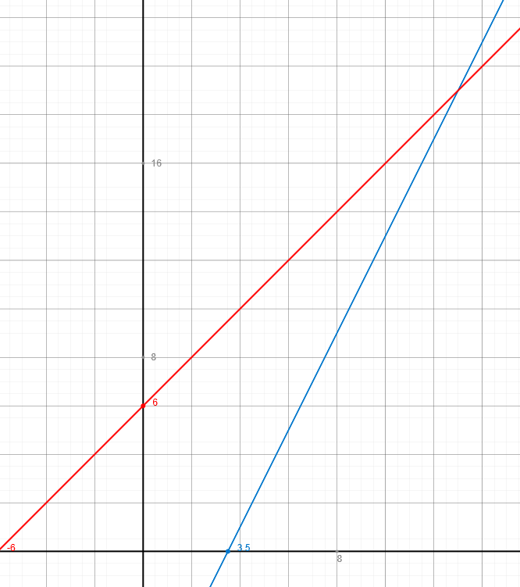







Example
$$2x−7=x+6$$
$$−x$$
$$x−7=6$$
$$y=x+6$$
$$+7$$
$$x=13$$
$$y=2x−7$$

Slide 15
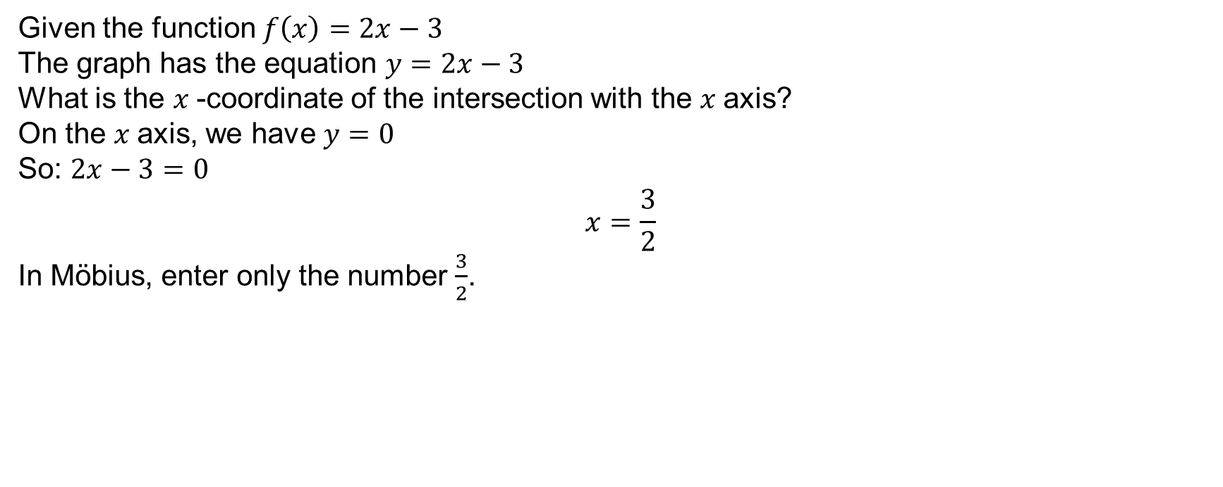

Intersection point with axis
Given the function $f\left(x\right)=2x−3$
The graph has the equation $y=2x−3$
What is the $x$-coordinate of the intersection with the $x$axis?
On the $x$axis, we have $y=0$
So: $2x−3=0$
$$x=\frac{3}{2}$$
In Möbius, enter only the number $\frac{3}{2}$.

Slide 16
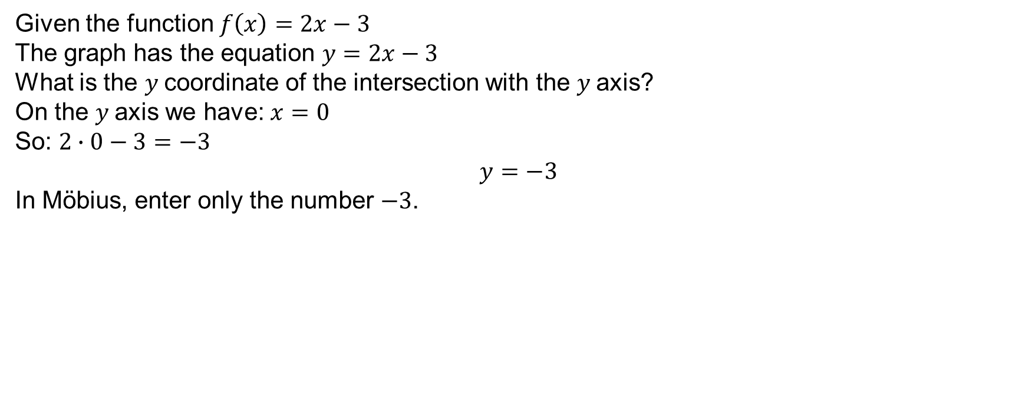

Intersection point with axis
Given the function $f\left(x\right)=2x−3$
The graph has the equation $y=2x−3$
What is the $y$coordinate of the intersection with the $y$axis?
On the $y$axis we have: $x=0$
So: $2∙0−3=−3$
$$y=−3$$
In Möbius, enter only the number $−3$.

Slide 17







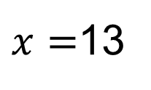

Two intersecting lines
$$y=2x−7$$
$$y=x+6$$
$$2x−7=x+6$$
$$−x$$
$$y=x+6$$
$$x−7=6$$
$$+7$$
13
$$y=2x−7$$
$$y=x+6$$
so
$$y=19$$
The system of equations has as its solution:
x = 13, y = 19

Slide 18
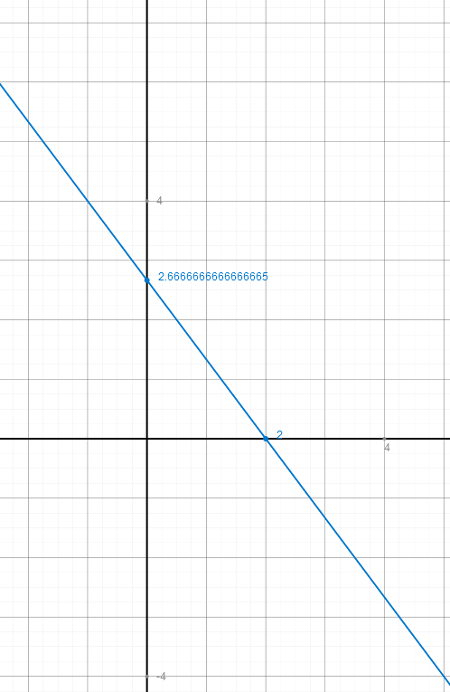
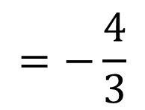




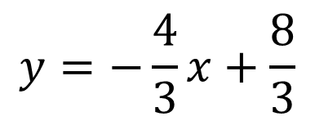

Implicit equation of a line
$$4x+3y=8$$
What is the slope?
$$4x+3y=8$$
$$−4x$$
$$3y=−4x+8$$
$$y=−\frac{4}{3}x+\frac{8}{3}$$
$$/3$$
$$=−\frac{4}{3}$$
slope

Slide 19
Need more explanation and practice?
Go to the course on Brightspace

